Slide 1
VueJS
ITA / Intern Training
Antony Zhang
2017.07.11

Slide 2
Agenda
1
Introduction of Vue.js
2
Vue instance
3
Template Syntax
4
Computed Properties and Watchers
5
Class and Style Bindings
6
History
7
Library & Framework
8
Tag & Script

Slide 3
1
Introduction of VueJS
What is Vue?
My first Vue.js application
Declarative rendering

Slide 4
1.1
What is Vue?
Vue is a progressive framework for building user interfaces
Vue is designed from the ground up to be incrementally adoptable
The core library is focused on the view layer only
Easy to pick up and integrate with other libraries or existing projects
Vue is also perfectly capable of powering sophisticated Single-Page Applications

Slide 5
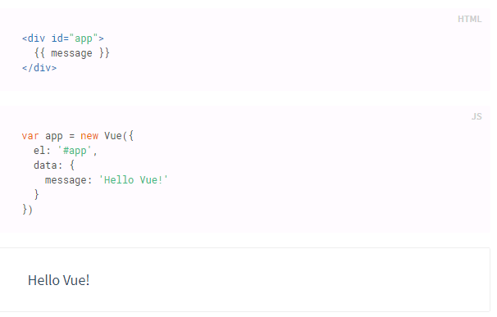
1.2
My First Vue Applicatoin

Slide 6
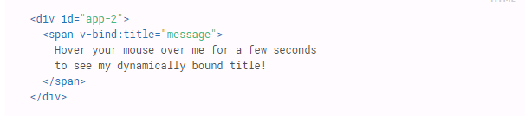
1.3
Declarative Rendering
Vue.js use {{ }} to render data in page
Vue.js use v-bind directive to render data in page.
v-bind:title is same as :title

Slide 7
1.3
Conditionals and Loops
v-if
v-for
<p v-if="seen">Now you see me</p>
<li v-for="todo in todos">
{{ todo.text }}
</li>

Slide 8
1.3
Handling User Input
Use v-on directive to attach event listeners
v-on:click
v-on:mouseover
v-on:focus
v-on:blur
…
v-on:click=“…” same as @click=“…”
Use v-model to make two-way data binding

Slide 9
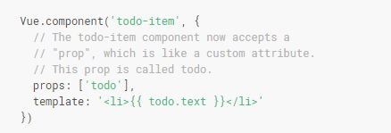
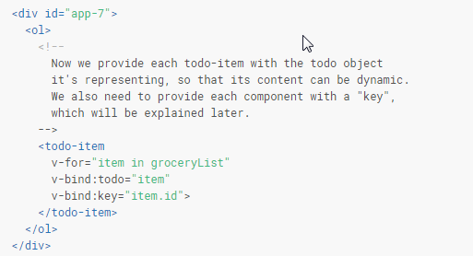
1.4
Composing with Components
How to define a customized component:
How to use a customized component:

Slide 10
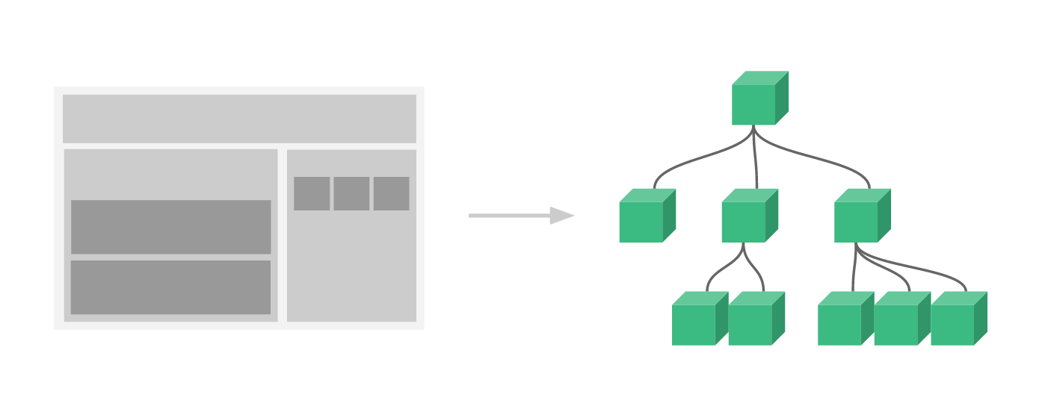
1.4
Composing with Components
<div id="app"> <app-nav></app-nav> <app-view> <app-sidebar></app-sidebar> <app-content></app-content> </app-view> </div>

Slide 11
2
Instance of Vue
Constructor
Properties and Methods
Lifecycle

Slide 12

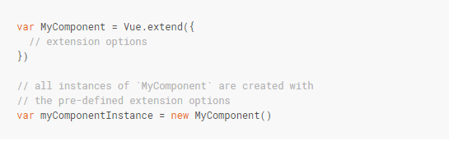
2.1
Constructor
Create an Vue instance with new Vue()
The Vue constructor can be extended to create reusable component constructors with pre-defined options

Slide 13
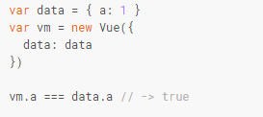
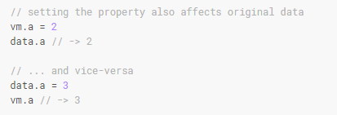
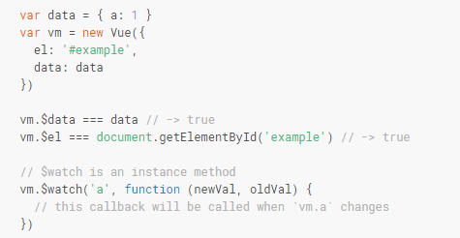
2.2
Properties and Methods
Each Vue instance proxies all the properties found in its data object, and it is reactive.
These properties and methods are prefixed with $ to differentiate them from proxied data properties

Slide 14
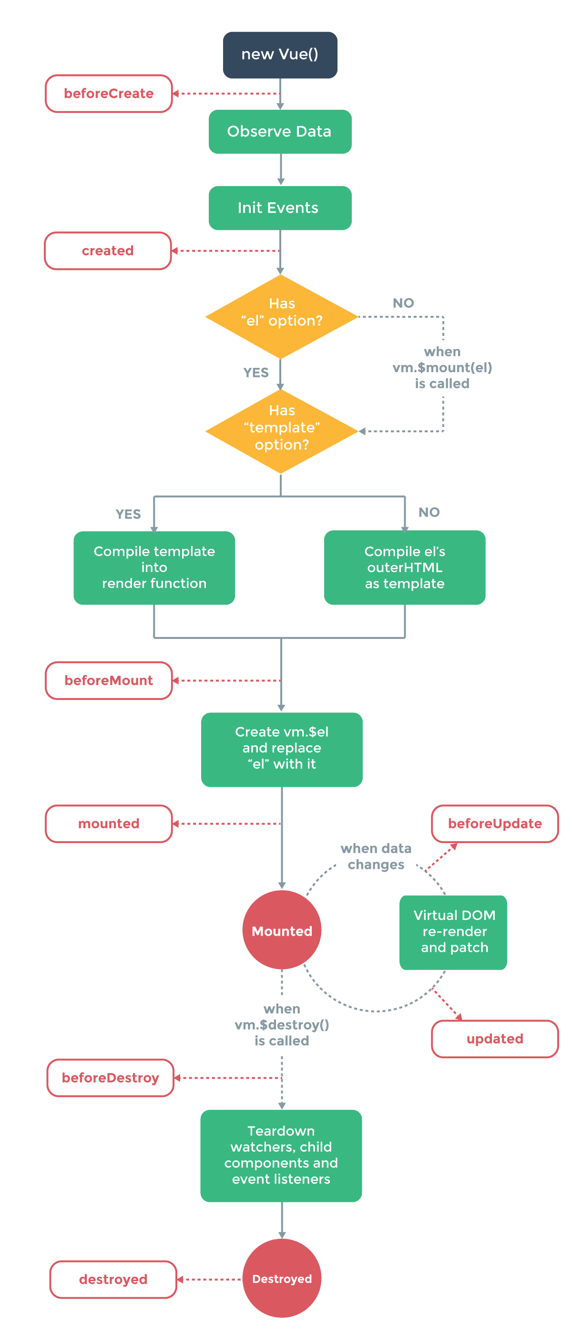
2.3
Lifecycle
If update data in the beforeUpdate hook or updated hook, what will happen?

Slide 15
3
Template Syntax
Interpolation
Directives
Filters
Shorthands

Slide 16
3.1
Interpolations
Text
Using the “Mustache” syntax:
<span>Message: {{ msg }}</span>
Using v-once to interpolate without updating.
<span v-once>This will never change: {{ msg }}</span>
Raw Html
Using v-html directive to output html.
<div v-html="rawHtml"></div>
Attributes
Mustache syntax can’t be used inside HTML attributes
Using v-bind directive to bind attributes.
<div v-bind:id="dynamicId"></div>
Using Javascript Expressions
Template expressions are sandboxed and only have access to a whitelist of globals such as Math and Date

Slide 17
3.2
Directives
Arguments
<a v-bind:href="url"></a>
<a v-on:click="doSomething">
Modifiers
<form v-on:submit.prevent="onSubmit"></form>
.prevent modifier tells the v-on directive to call event.preventDefault() on the triggered event
Notes:
Modifiers: 修饰符

Slide 18
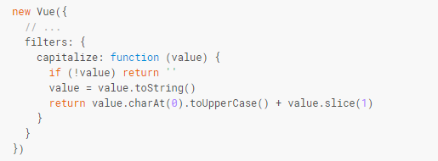
3.3
Filters
Filters are usable in two places: mustache interpolations and v-bind expressions.
{{ message | capitalize }}
<div v-bind:id="rawId | formatId"></div> (supported since 2.1.0)
Filters can be chained:
{{ message | filterA | filterB }}
Filter can take arguments:
{{ message | filterA('arg1', arg2) }} (message is first argument, ‘arg1’ is second argument, and arg2 returned value is third argument)
Define Vue filter:

Slide 19
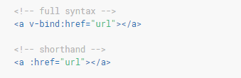
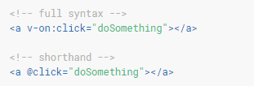
3.4
Shorthands
v-bind shorthand:
v-on shorthand:

Slide 20
Exercise 1
Render the table with initialized data (headers and row data)
User can filter each column by input
User can click the column header to sort table
Table is colorful.
If no result, should display “No result”
First Name↓ | Last Name | Gender | Departure
Antony | Zhang | M | CS
David | Li | M | OOCL
Lisa | Wang | F | HR
Michelle | Xiao | M | MKT
No Result

Slide 21
4
Computed Properties and Watchers
Computed Properties
Watchers
Notes:
Modifiers: 修饰符

Slide 22
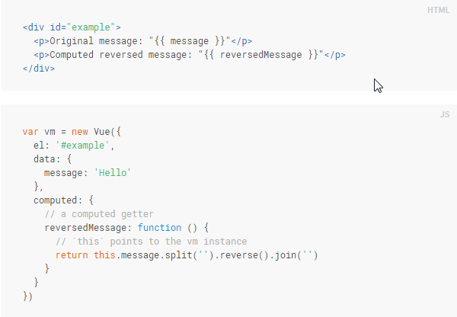
4.1
Computed Properties
Use computed properties for complex logic in templates.
How to define and use computed properties.
Notes:
Modifiers: 修饰符

Slide 23
4.2
Computed Properties
Computed caching VS method
For the end result, the two approaches are indeed exactly the same
Computed properties are cached based on their dependencies
Method invocation will always run the function whenever a re-render happens
In cases where you do not want caching, use a method instead
Computed VS Watched property
Watched property is used to observe and react to data changes.
Recommend to use computed instead of watched property.
Computed setter
Default getter-only
Possible to provide setter
Watchers
This is most useful when you want to perform asynchronous or expensive operations in response to changing data

Slide 24
5
Class and Style Bindings
Binding HTML Classes
Binding Inline Styles

Slide 25






5.1
Binding HTML Classes
Object syntax
Array syntax
With component
Notes:
Modifiers: 修饰符

Slide 26
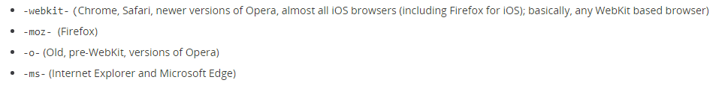
5.2
Binding Inline Styles
Object syntax
Array syntax
Auto-prefixing
Multiple values
Notes:
Modifiers: 修饰符

Slide 27
6
Conditional Rendering
v-if
v-else
v-else-if (support since 2.1.0)
v-show
v-if VS v-show
v-if VS v-for
Notes:
Modifiers: 修饰符

Slide 28

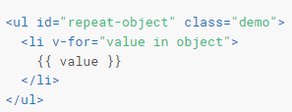


7
List Rendering
v-for
* Object v-for
* Range v-for
Key
Notes:
Modifiers: 修饰符

Slide 29
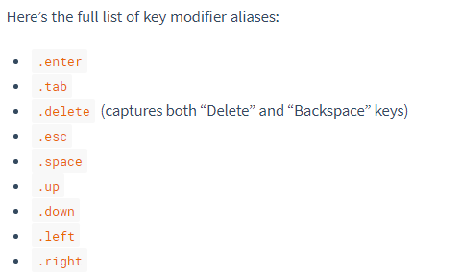
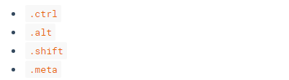

8
Event Handling
v-on directive to listen DOM event
Original DOM event: $event
Event Modifiers
.stop
.prevent
.capture
.self
.once (new in 2.1.4)
* Modifier can be chained
Key Modifiers
<input v-on:keyup.13="submit">
<input v-on:keyup.enter="submit">
Define custom key modifier alias
New in 2.1.0
How to handle event of click and keyup?
Notes:
Modifiers: 修饰符

Slide 30
9
Form Input Binding
v-model to two-way binding
v-model.lazy
v-model.number
v-model.trim
v-bind for one-way binding
<input type="checkbox" v-model="toggle" v-bind:true-value="a" v-bind:false-value="b">

Slide 31
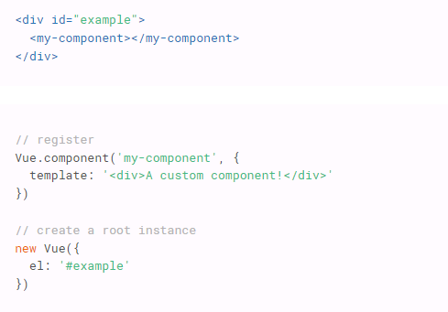
10
Components
Component Registration
Vue.component(tagName, options)
Make sure the component is registered before you instantiate the root Vue instance

Slide 32
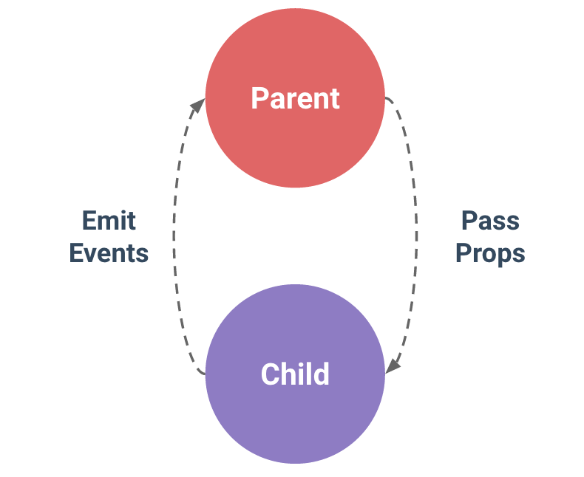
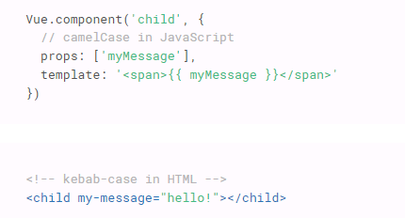
10
Components
Composing components
In Vue, the parent-child component relationship can be summarized as props down, events up. The parent passes data down to the child via props, and the child sends messages to the parent via events.
Passing data with props
Camel-Case VS Kebab-Case
Dynamic Props
Literal VS Dynamic

Slide 33
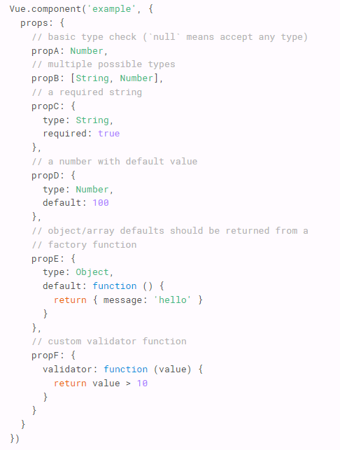
10
Components
One-way Data Flow
Prop Validation
String
Number
Boolean
Function
Object
Array
Symbol
Using v-on with Custom Event
.sync modifier (From 2.3.0)
Notes:
Modifiers: 修饰符

Slide 34
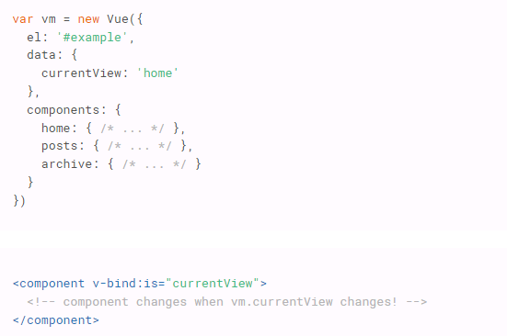
10
Components
Content Distribution with Slots
Single Slot
Named Slots
Scoped Slots (From 2.1.0)
Dynamic Component
keep-alive element

Slide 35
11
Mixins
Notes:
Modifiers: 修饰符

